Slide 1

Enigma HR Solutions: A Modern Full-Stack HR Application

Slide 2
TECH STACK
Backend
Node js
Express js
Database
MySQL (initialized when server is started)
Frontend
Angular
Auth0 sso
OIDC auth, RBAC
Integrated with Jenkins, Google and Github
Jenkins CICD
Ngrok for TLS encryption

Slide 3
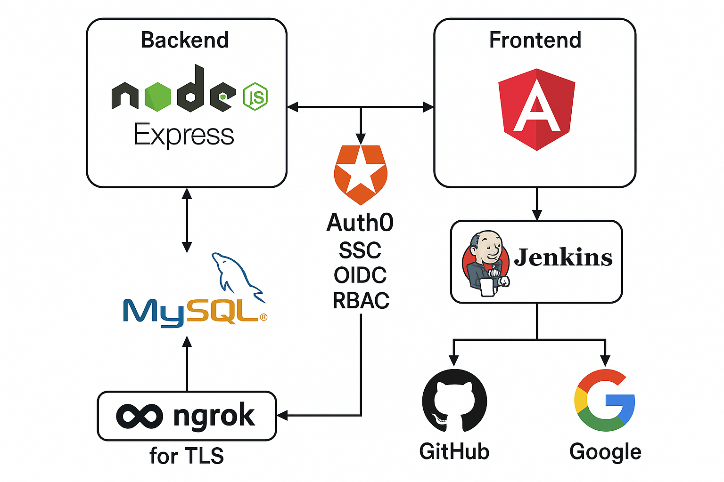
System Architecture:

Slide 4
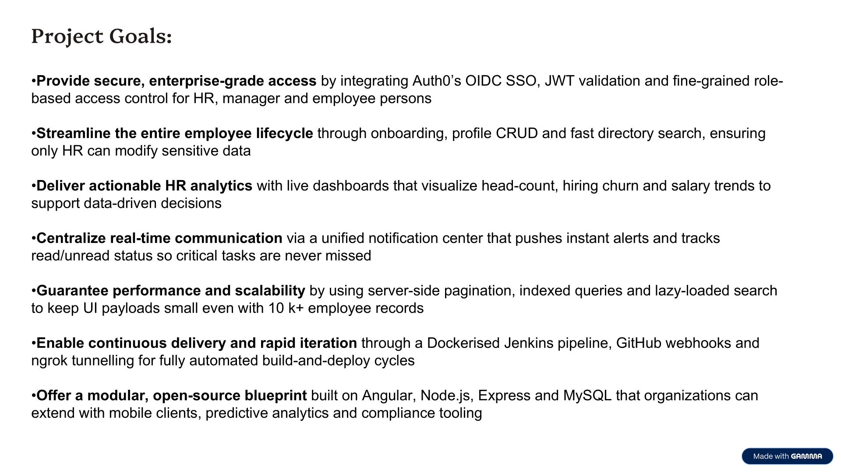

Slide 5

Secure Authentication & Authorization with Auth0 Integration
Auth0 Integration
Role-Based Access Control
Enterprise-grade authentication service - OIDC auth code flow
Defined roles include HR, manager, and employee, with specific permissions to restrict sensitive operations.
JWT Token Verification
Robust token validation mechanism protecting API endpoints from unauthorized access.

Slide 6

Auth0 SSO & OIDC - auth code flow
[1] User opens frontend (Angular app)
│
▼
[2] Frontend redirects to Auth0 login (via Auth0 SDK)
│
▼
[3] User logs in → Auth0 redirects back to frontend with authorization code
│
▼
[4] Frontend sends the code to the backend (Node.js)
│
▼
[5] Backend exchanges code with Auth0 for:
→ Access Token

Slide 7
Challenges Faced – Syncing Auth0 Users with Database
Users logged in via Auth0 but were missing in the MySQL `employees` table.
Automatically detect first-time logins and sync new users to the database.
User with admin privileges (HR) can add addition information like Department, Salary, etc once user has logged in.

Slide 8
Comprehensive Employee Management with Role Restrictions
CRUD Operations
Role-Based Editing
Employee Search
Complete creation, read, update, and deletion functionalities for employee records ensuring accurate data management.
Only users with HR roles have full management access.
Efficient search functionality enabling quick retrieval of employee information within large datasets.

Slide 9

Interactive Dashboard & HR Analytics
Quick Actions
One-click access to:
View Team Members
Onboard New Employees
Check personal notifications and announcements
Analytics & Trends
Employee Statistics
Headcount by department
New hires vs. departures
Salary Statistics & Trends
Average salary by role
Month-over-month analysis

Slide 10
Role-Based Access Control (RBAC)
Onboarding
Only HR users can initiate onboarding
Announcements
HR-only permissions to create, edit, or delete posts
Performance Optimizations
Server-Side Pagination
Loads only current page of employee data
Reduces UI rendering time and bandwidth
Lazy-Loading Search
Fetches matching results on demand
Minimizes initial payload and improves responsiveness
Employee Directory Permissions
HR Users
Full CRUD access (Create, Read, Update, Delete)
All Other Users
Read-only: View list and open profiles

Slide 11



Real-Time Notification System for Enhanced Communication
Real-Time Updates
Notifications appear instantly as events happen.
Users are always informed of new tasks or changes.
Reduces delays in responding to important actions.
2
Centralized Notification Center
1
All alerts and reminders are shown in one unified page.
Easy access from anywhere in the application.
No need to check multiple sources for updates.
Read/Unread Status
Unread notifications are clearly highlighted.
Users can easily track what’s new or pending.
Helps manage and organize important information.
3

Slide 12
My Profile Page – Secure, Role-Based Access to Employee Information
The "My Profile" page offers a clear and comprehensive view of each user's personal and professional details.
Information such as name, department, job title, and contact details is neatly displayed for easy reference.
All employees can view their own profile data to verify and stay updated on their records.
Only HR users have permission to edit profile information, ensuring sensitive data is protected.
This role-based restriction maintains the integrity and security of employee records across the organization.

Slide 13

Advanced Team Management and Visualization
Team Member Visualization
Search and Access Control
Visualize department-wise team structures with live employee data, including roles, designations, and reporting lines. Enables intuitive navigation through org charts and current team compositions.
Secure and scoped team access: search and team data visibility is dynamically scoped based on authenticated user identity (emp ID from Auth0).

Slide 14

CI/CD Integration Summary
Integrated Jenkins CI/CD with the GitHub repository
Created a pipeline to install dependencies and build both backend and Angular frontend
Hosted Jenkins locally using Docker
Exposed Jenkins to the internet using ngrok
Configured a GitHub webhook to trigger the pipeline on every code push
Achieved automated builds and continuous integration for the project
Notes:
1. Why Jenkins? “We used Jenkins to set up a CI/CD pipeline for our project to automate builds
2. Jenkins Pipeline Setup “We created a declarative Jenkins pipeline that installs dependencies and builds both the backend and frontend parts of our project.
3. Local Hosting with Docker “We ran Jenkins locally in a Docker container and used ngrok to expose it to the internet temporarily. This gave us a public URL needed to set up webhooks from GitHub.”
5. GitHub Webhook Trigger “We configured a webhook in our GitHub repo to hit Jenkins on every push. This automated our builds — any time we pushed code, Jenkins automatically ran the pipeline.”
6. Impact “This setup allowed us to achieve true CI — our builds are automatic, reproducible, and consistent. It helped us ship code faster and with more confidence.”

